Slide 1


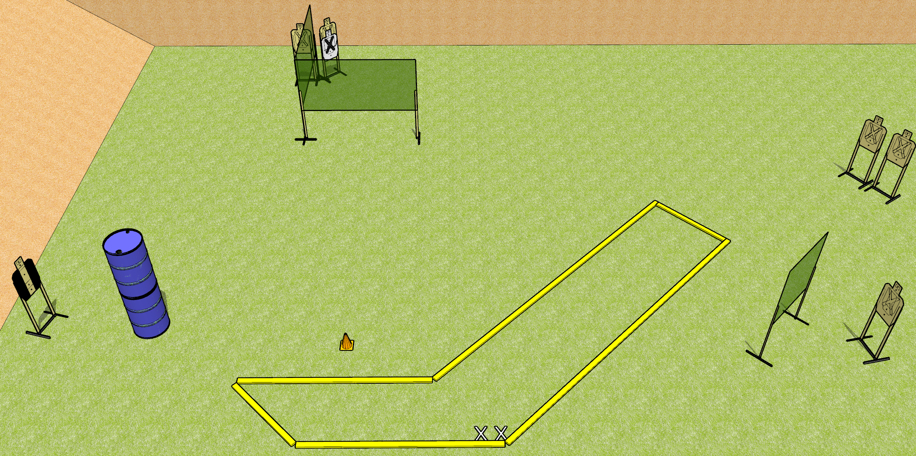
 | Dothan Gun Club – USPSA Match Check it Out Course Designer : Drew Coleman
START POSITION : Standing with both feet on X’s, wrists below belt
GUN READY CONDITION : Pistol loaded and holstered. PCC loaded, held with both hands, shouldered, safety on, pointed at orange cone. |  | SCORING: Virginia Count, 12 rounds TARGETS: 6 paper, 0 Steel SCORED HITS: Best 2 on paper, steel until down START-STOP: Audible, last shot RULES:
STAGE PROCEDURE: Engage targets as they become available from within the fault lines.

Slide 2
Check it Out
Written Stage Briefing
Check it Out is a 12 round, 60 point, Virginia count short course. There are six USPSA targets. The best two hits per target will score. The start signal is audible.
Handgun start position is standing with both feet on X’s, wrists below belt. Handgun is loaded and holstered.
PCC start position is standing with both feet on X’s, muzzle pointed at orange cone. Loaded carbine is held with both hands, shouldered, safety on.
On start signal, engage each target with only two rounds each from within the shooting area.

Slide 3
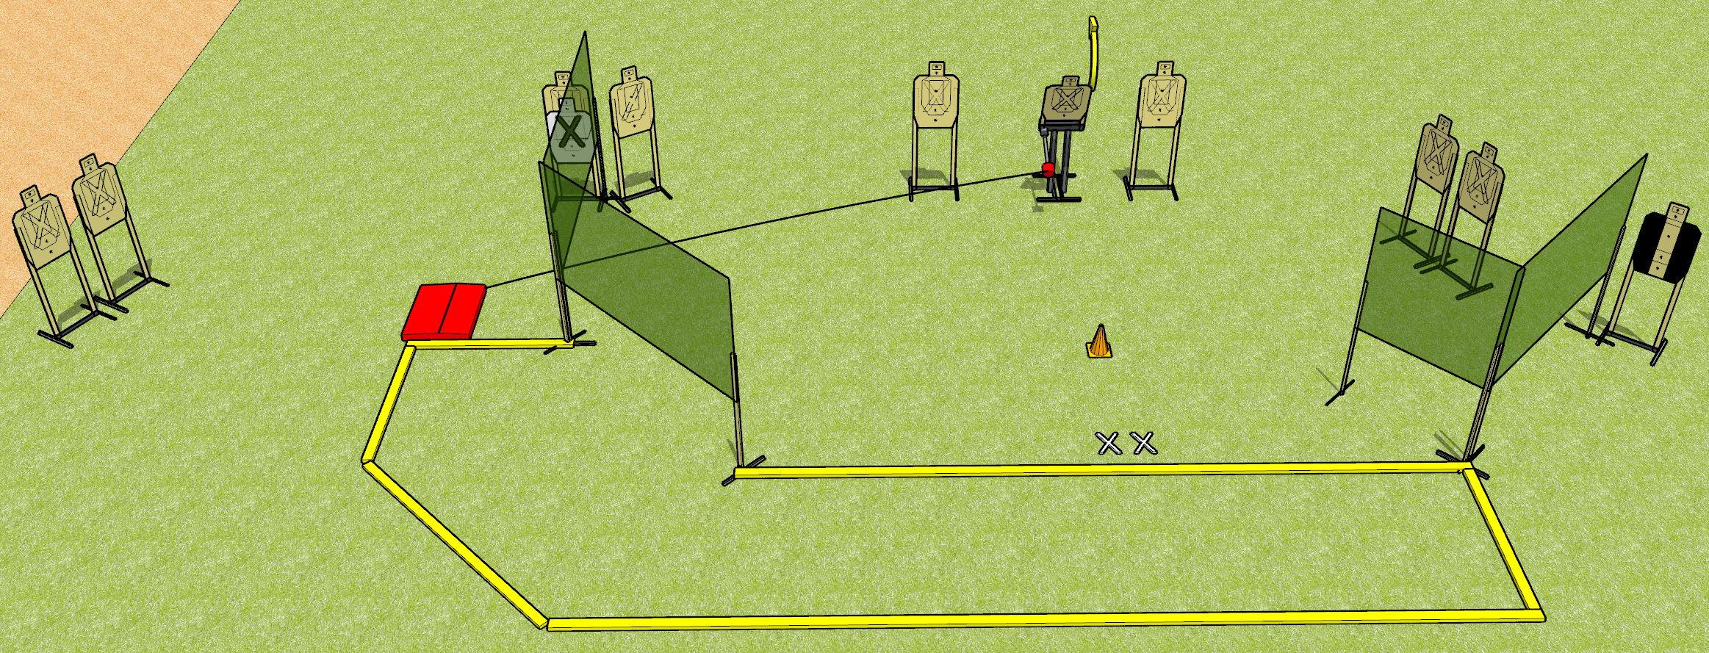
 | Dothan Gun Club – USPSA Match Pop! Course Designer : Drew Coleman
START POSITION : Standing with both feet on X’s, wrists below belt
GUN READY CONDITION : Pistol loaded and holstered. PCC loaded, held with both hands, shouldered, safety on, pointed at orange cone. |  | SCORING: Comstock, 20 rounds TARGETS: 10 paper, 0 Steel SCORED HITS: Best 2 on paper, steel until down START-STOP: Audible, last shot RULES:
STAGE PROCEDURE: Engage targets as they become available from within the fault lines.

Slide 4
Pop!
Written Stage Briefing
Pop! is a 20 round, 100 point, Comstock medium course. There are 10 USPSA targets. The best two hits on paper will score. The start signal is audible.
The popup target is activated by the stomp box and must be activated prior to being engaged. Please check the activators prior to stage walkthrough, and set it up the same way every time.
Handgun start position is standing with both feet on X’s, wrists below belt. Handgun is loaded and holstered.
PCC start position is standing with both feet on X’s, muzzle pointed at orange cone. Loaded carbine is held with both hands, shouldered, safety on.
On start signal, engage targets as they become available from within the shooting area.

Slide 5
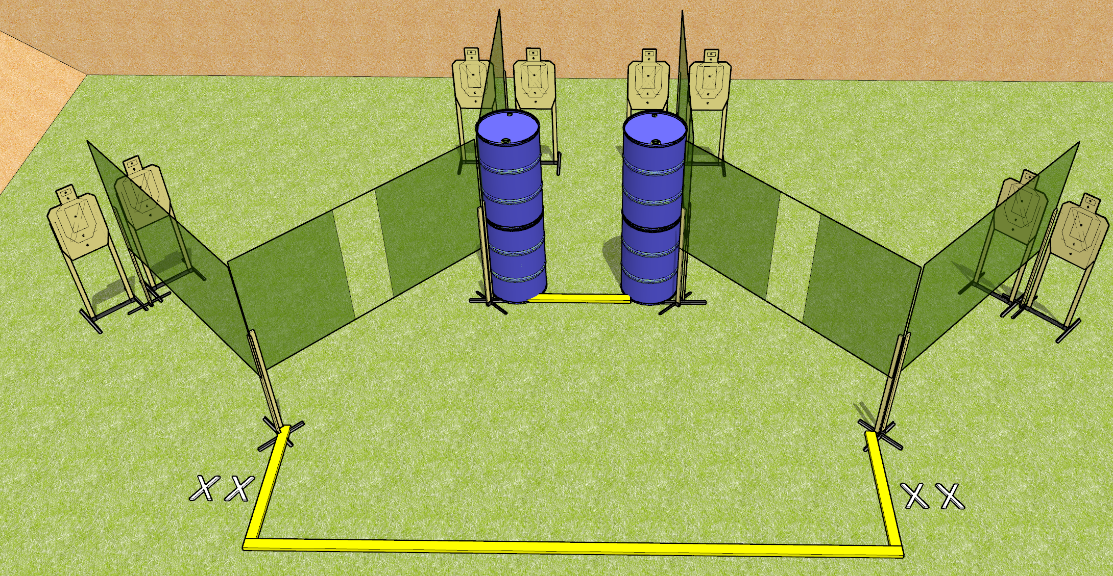
 | Dothan Gun Club – USPSA Match Deja Vu Course Designer : Drew Coleman
START POSITION : Standing with both feet on X’s, wrists above shoulders
GUN READY CONDITION : Pistol loaded and holstered. PCC loaded, held with both hands, safety on, stock on belt. |  | SCORING: Comstock, 24 rounds TARGETS: 8 paper, 0 Steel SCORED HITS: Best 3 on paper, steel until down START-STOP: Audible, last shot RULES:
STAGE PROCEDURE: Engage targets as they become available from within the fault lines.

Slide 6
Deja Vu
Written Stage Briefing
Deja Vu is a 24 round, 120 point, Comstock field course. There are eight USPSA targets. The best two hits on paper will score. The start signal is audible.
Handgun start position is standing on either set of X’s, wrists above shoulders. Handgun is loaded and holstered.
PCC start position is standing on either set of X’s. Loaded carbine is held with both hands, stock on belt, safety on.
On start signal, engage targets as they become available from within the shooting area.

Slide 7
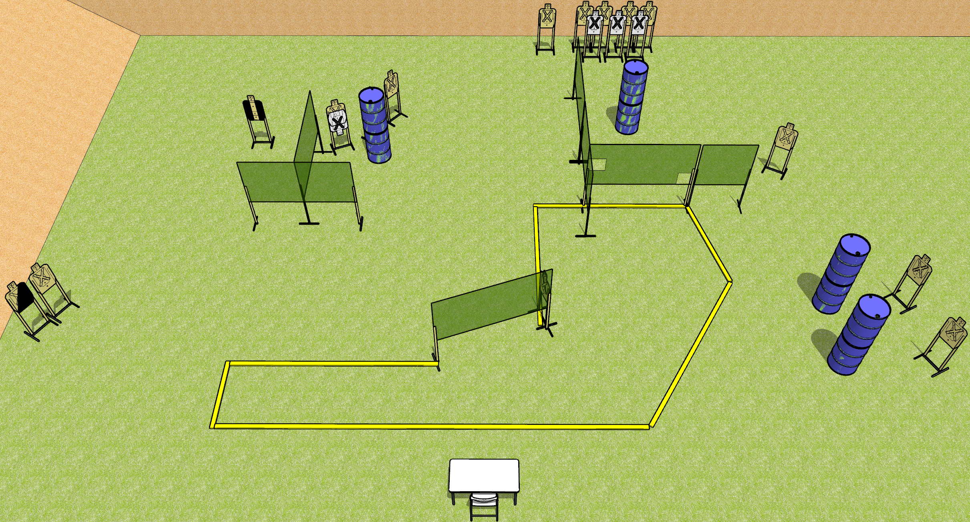
 | Dothan Gun Club – USPSA Match Load ‘em Up Course Designer : Drew Coleman
START POSITION : Sitting in chair, feet flat on ground, back against seat back, hands touching outermost left and right marks, palms flat.
GUN READY CONDITION : firearm is unloaded with trigger guard on either black mark, laying unsupported. First magazine for stage is placed on other black mark. |  | SCORING: Comstock, 30 rounds TARGETS: 15 paper, 0 Steel SCORED HITS: Best 2 on paper, steel until down START-STOP: Audible, last shot RULES:
STAGE PROCEDURE: Engage targets as they become available from within the fault lines.

Slide 8
Load ‘em Up
Written Stage Briefing
Load ‘em Up is a 30 round, 150 point, Comstock field course. There are fifteen USPSA targets. The best two hits on paper will score. The start signal is audible.
Start position is seated in chair, feet flat on ground, back against seat back. Hands are palms flat on table, touching outermost left and right marks. Firearm is unloaded with trigger guard on either inner mark, unsupported. First magazine to be used is laying on the other inner mark. All other magazines may come from belt.
On start signal, engage targets as they become available from within the shooting area.

Slide 9
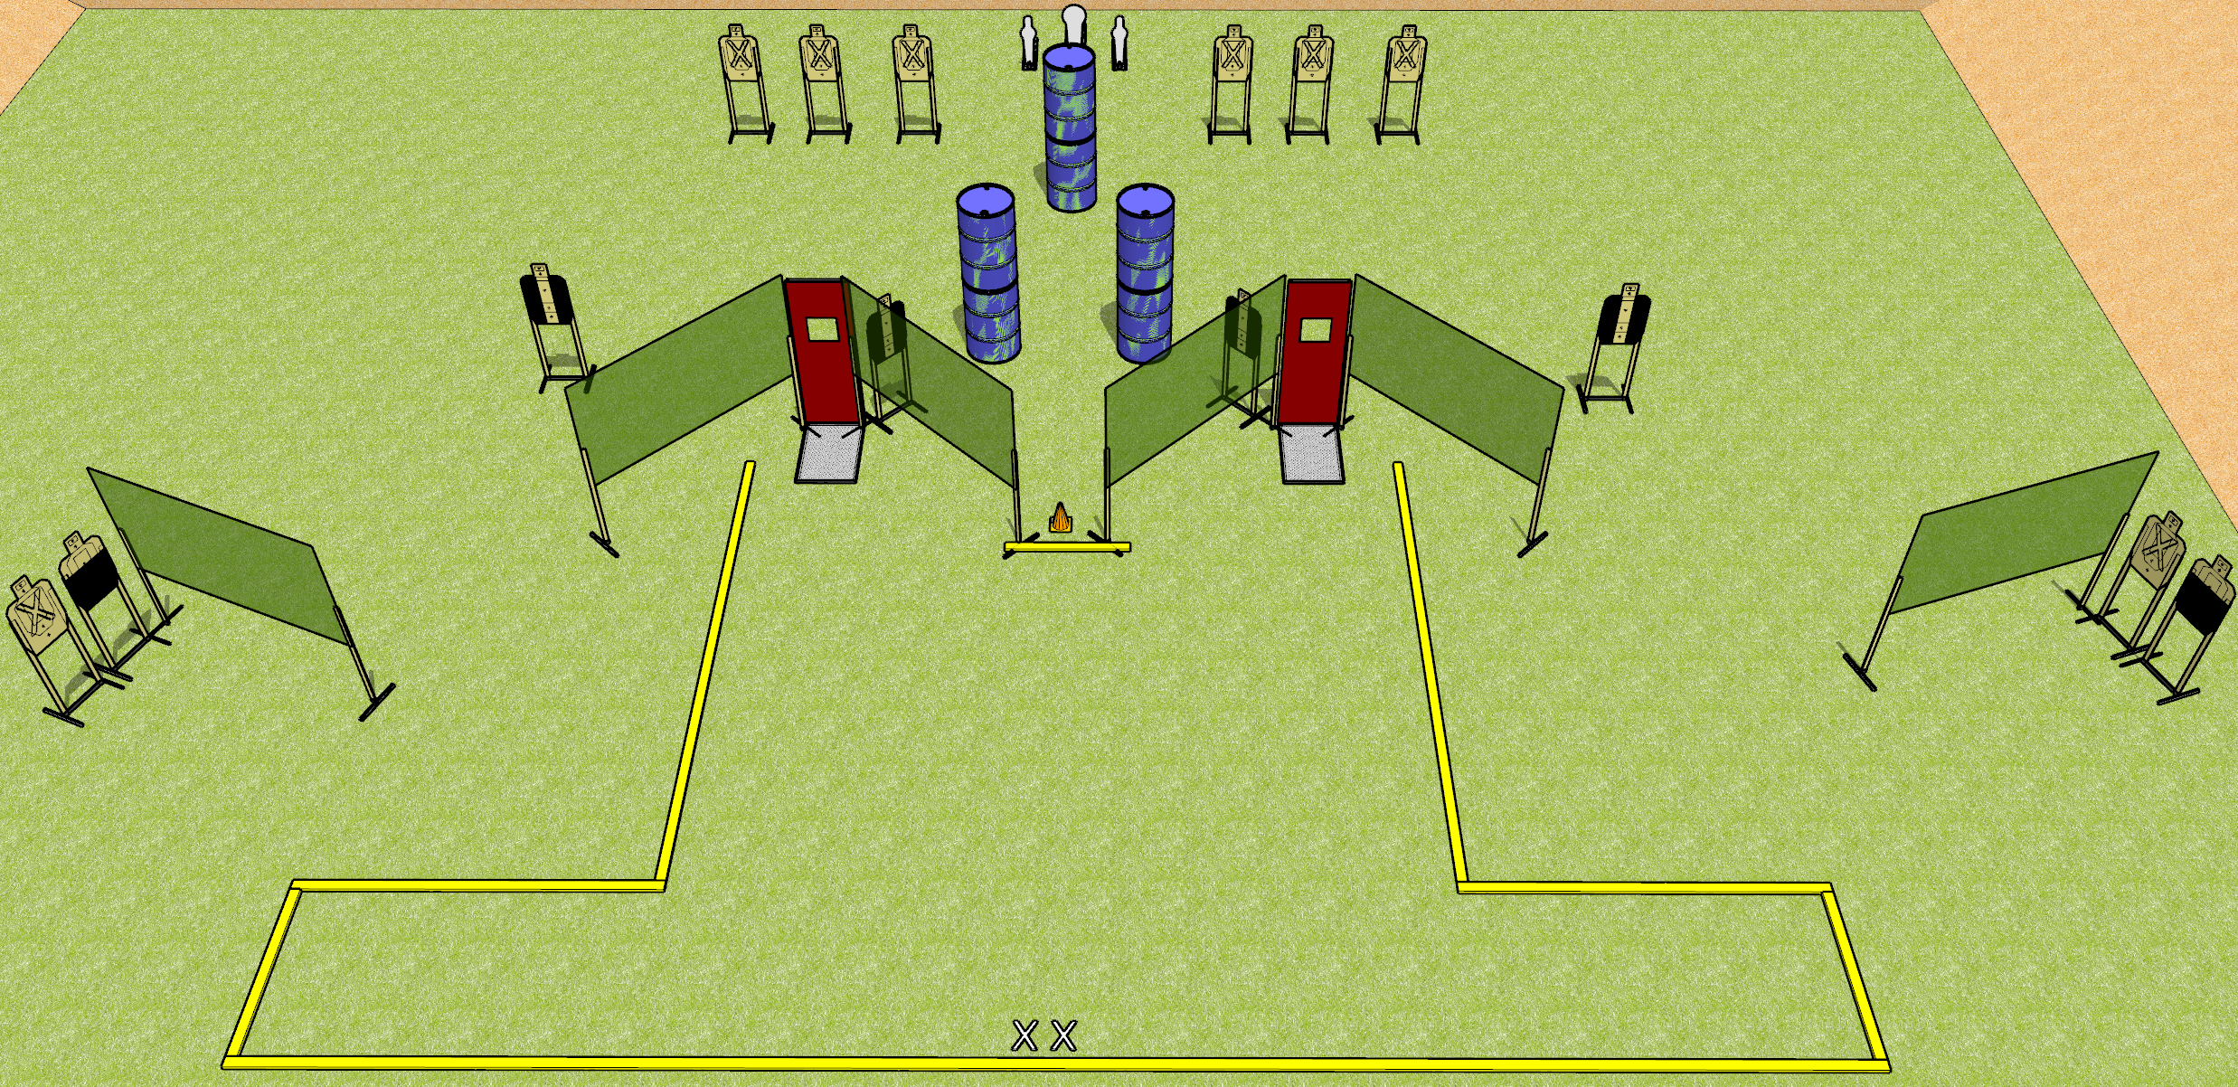
 | Dothan Gun Club – USPSA Match Maximum Fuckery Course Designer : Drew Coleman
START POSITION : Standing with both feet on X’s, wrists below belt
GUN READY CONDITION : Pistol loaded and holstered. PCC loaded, held with both hands, shouldered, safety on, pointed at orange cone. |  | SCORING: Comstock, 31 rounds TARGETS: 14 paper, 3 Steel SCORED HITS: Best 2 on paper, steel until down START-STOP: Audible, last shot RULES:
STAGE PROCEDURE: Engage targets as they become available from within the fault lines.

Slide 10
Maximum Fuckery
Written Stage Briefing
Maximum Fuckery is a 31 round, 155 point, Comstock field course. There are fourteen USPSA targets, one Colt popper, and two mini poppers. The best two hits on paper will score, and steel must fall to score. The start signal is audible.
Handgun start position is standing with both feet on X’s, wrists below belt. Handgun is loaded and holstered.
PCC start position is standing with both feet on X’s, muzzle pointed at orange cone. Loaded carbine is held with both hands, shouldered, safety on.
On start signal, engage targets as they become available from within the shooting area.

Slide 11
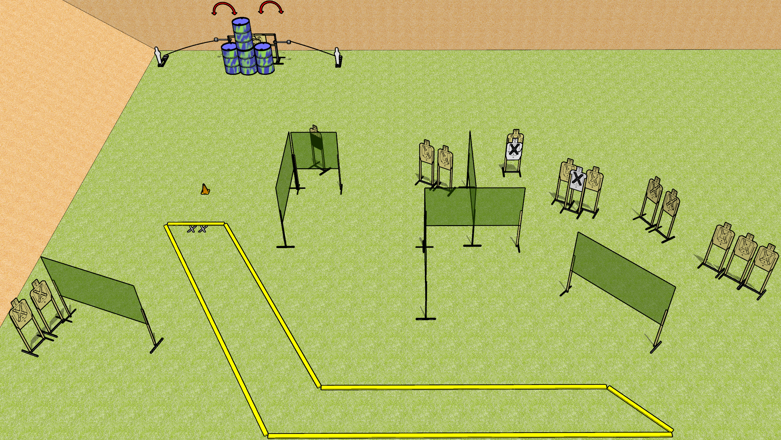
 | Dothan Gun Club – USPSA Match Back it Up Course Designer : Drew Coleman
START POSITION : Standing with both feet on X’s, wrists below belt
GUN READY CONDITION : Pistol loaded and holstered. PCC loaded, held with both hands, shouldered, safety on, pointed at orange cone. |  | SCORING: Comstock, 32 rounds TARGETS: 15 paper, 2 Steel SCORED HITS: Best 2 on paper, steel until down START-STOP: Audible, last shot RULES:
STAGE PROCEDURE: Engage targets as they become available from within the fault lines.

Slide 12
Back it Up
Written Stage Briefing
Back it Up is a 32 round, 160 point, Comstock field course. There are fifteen USPSA targets and two mini poppers. The best two hits on paper will score, and steel must fall to score. The start signal is audible.
The left swinger is activated by the left poppers, and the right swinger by the right popper. Please check the activators before walkthrough and set the same way every time.
Handgun start position is standing with both feet on X’s, wrists below belt. Handgun is loaded and holstered.
PCC start position is standing with both feet on X’s, muzzle pointed at cone. Loaded carbine is held with both hands, safety on, shouldered.
On start signal, engage the targets as they become available from within the shooting area.

Slide 13
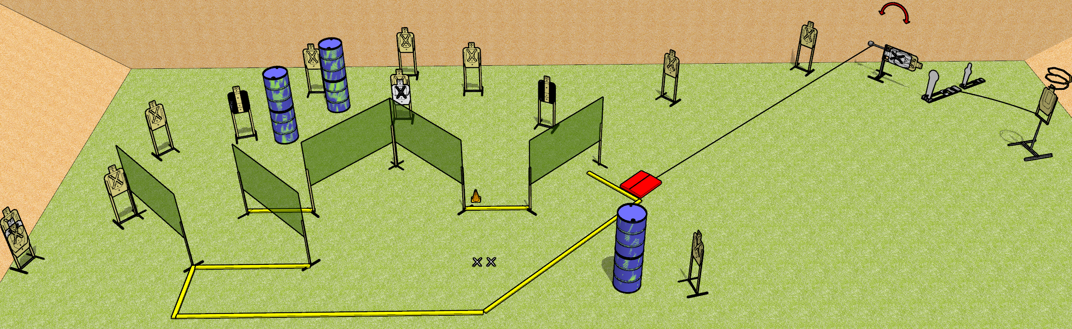
 | Dothan Gun Club – USPSA Match One Mean Mover Course Designer : Drew Coleman
START POSITION : Standing with both feet on X’s, wrists below belt
GUN READY CONDITION : Pistol loaded and holstered. PCC loaded, held with both hands, shouldered, safety on, pointed at orange cone. |  | SCORING: Comstock, 32 rounds TARGETS: 15 paper, 2 Steel SCORED HITS: Best 2 on paper, steel until down START-STOP: Audible, last shot RULES:
STAGE PROCEDURE: Engage targets as they become available from within the fault lines.

Slide 14
One Mean Mover
Written Stage Briefing
One Mean Mover is a 32 round, 160 point, Comstock field course. There are fifteen USPSA targets, one Colt popper, and one mini popper. The best two hits on paper will score, and steel must fall to score. The start signal is audible.
The swinger is activated by the stomp box. The drop turner is activated by the Colt popper, and it is a disappearing target. Please check the activators before walk through and set them the same way every time.
Handgun start position is standing with both feet on X’s, wrists below belt. Handgun is loaded and holstered.
PCC start position is standing with both feet on X’s, muzzle pointed at cone. Loaded carbine is held with both hands, shouldered, safety on.
On start signal, engage targets as they become available from within the shooting area.

